Slide 1
same problems, diFferent concepts
Gergely Wintsche
Eötvös Loránd University (ELTE), Hungarian Institute for Educational Research and Development (OFI)
(diFferent Groups)
Notes:
I complete it with

Slide 2
Content
Text based or concept problems?
a) the zero problem
b) the sentence problem
The probability problem
Notes:
I will give two contextual or text or word and logic based problems and I think I will not have time for the probability problem.
By the way there were different difficulties for the different groups in all af the three problems.

Slide 3
Contextual or concept problems
The different parts of the same problems could cause severe problems in different student groups. If the interpretation of one part of the group is on a language baseline and it is significantly different from the interpretation of the others, who prefer the mathematical language could cause an inevitable problem.
Notes:
Először a dia.
But before I start it let us have a short look out for the Hungarian educational system
for the deeper understanding of the origin of the problems.

Slide 4
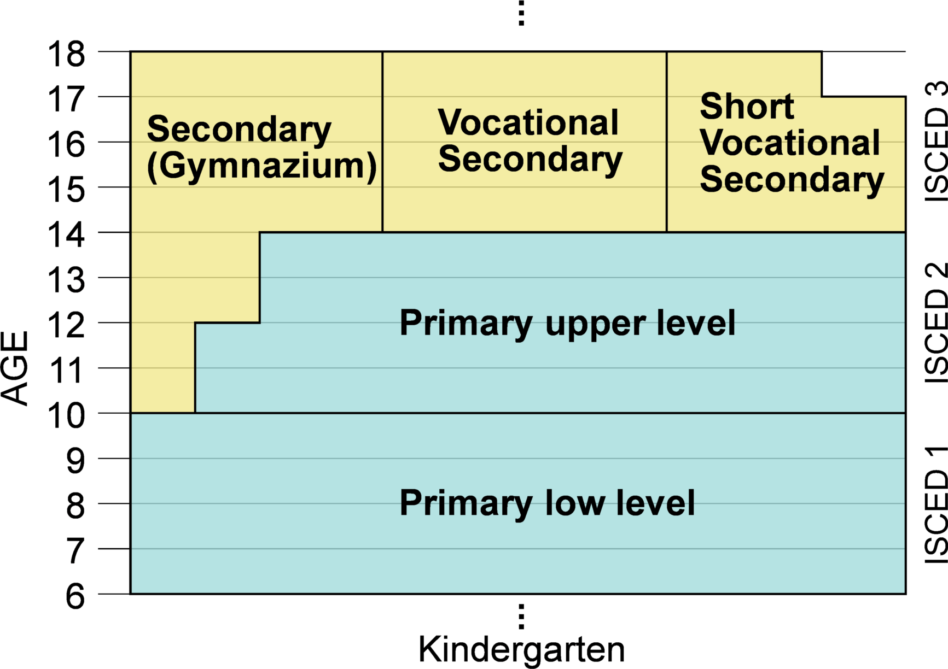
The part of the Hungarian educational system
Notes:
I will not talk about the whole educational system.
The Hungarian school system consist of 8+4 school years basically but there are also 6+6 and 4+8 partitions of the 12 grades.
One can have the possibility to take an entrance exam into a secondary (so called gymnasium) after the first 4 or 6 grades.
The written part of the entrance examination is organised and coordinated by the Educational Authority
and consist of the two main subjects Hungarian grammar & literature and mathematics.
Both of the tests are 50 points. I give some statistics about the schools and the results on the next slide.

Slide 5
 | 10-year-old 8 years high school | 12-year-old 6 years high school | 14-year-old 4 years high school
Number of schools | 85 | 115 | app. 1000
Number of written tests | 5411 | 7048 | 48 698
Number of admitted | 3104 | 4392 | everybody
Average math points | 28.2 | 22.3 | 18.5
Notes:
You can see that there are more than 1000 secondary schools and only 85 offer 8 years of school.
The number of the written test is more than 5000 and the number of admittion is approximately 3000.
You can see more data on the sheet.
The average math point is higher for the ten year old population.

Slide 6
Contextual or concept problems
The test is hard
The test is short
The test is unusual
http://www.oktatas.hu/pub_bin/dload/kozoktatas/beiskolazas/2015/OH_honlap_felveteli_eredmenyek_2007_2016.pdf
Notes:
The organisers are accused from year to year that the tests are very sophisticated and almost impossible to write it
within 45 minutes and these statements are true. How can we interpret these tests and the results?
Is it a basic segregation or chance for the gifted students to entry a better high school? The doors are open for everybody.
You can saw one of the plenary lecture that Hungary is a supportive country for the gifted students.
I will not mention the other end of the didtribution now.
As I mentioned before the level of the tests are surprising for many children and parents
Although the tests and the statistics from the earlier years are available. By the way I like these problems because one must have thinking if he wants to solve the test.
But also true that these test results and high schools are not communicated properly by the Educational Authority.
The lack of communication and the different level of the elementary schools could cause that an eminent student
can write mid level tests or worse.
After these preliminary I will show two problems from 2016.
The main reason is that my colleagues started a letter flow about these problems in January.

Slide 7
1st problem
Uncle Alexander keeps animals. There are only goats, horses and lambs on his farm. There are 2 less goats and 11 less horses than lamb.
a) How many lamb has Uncle Alexander at least?
b) Which animal has the fewest in the farm?
c) There are more than 30 but less than 40 animals on the farm. How many animal has Uncle Alexander from the different types of animals?
Write the possible numbers into the table below.
(There are more space then possibilities. Be careful! If you write wrong numbers than you can get negative points!)
Notes:
I am just talking but you can solve the problem. (If I were more time I could sum your answers up.)
An interesting arguing arose among some mathematicians. It is originated from the official and accepted solutions.
Every people had a very hard job if he had to accept a different solution. You can hear it in the earlier presentations.
There were many self-confident mathematicians and they had normally that there is only one proper solution. His own one.
Thanks god there were also some open minded colleagues who thought over the formalized question.
Where could be the chance to get anyone a different solution? That is perfect. We awaited this fenceless thinking from the teachers.
Let them able to understand different arguing moreover let the teachers able to pre imagine the possible way of solutions.
It is not an easy and trivial wish it is really hard if the mind thread absolutely different from our own set of mind.
I am sure you solved the problem.

Slide 8
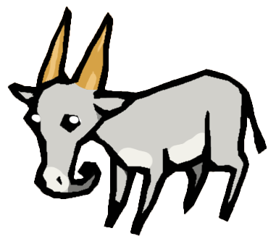
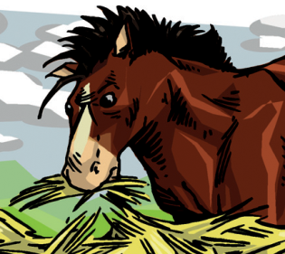
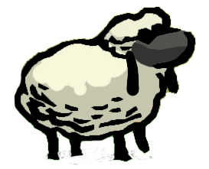
1st problem
Uncle Alexander keeps animals. There are only goats, horses and lambs on his farm. There are 2 less goats and 11 less horses than lamb.
a) How many lamb has Uncle Alexander at least?
Goats | 9 | 10
Horses | 0 | 1
Lambs | 11 | 12
Notes:
The question a) is interesting only. The problem originated from the usage, the meaning and the understanding of two words and a list.
Namely the “are”, the “only” and the ”goats, horses and lambs”.
There were people who means the {goat, horse, lamb} set is existing with at least one element so the set is nonempty.
In this situation it is allowed to be only 0 of a particular animal.
We have 0 horse. You know the mathematicians use this statement „we have zero horse”
In this case the solution is 11 for the question a). It is interesting that this interpretation was typical of the mathematicians.
There were some people who interpreted the text that if it is the abbreviation of the
“There are goats there are horses and there are lambs on his farm only.”
This means that there are at least one of every type of animals. In this case the solution is 12 for the question a).

Slide 9
1st problem
Is this really a problem?
Is it a problem for students?
Is it a problem for teachers?
Is it a problem for mathematicians?
Notes:
I was curious that this is a real problem for the 10-year-old pupils or not?
That is why I asked the whole database of the test results from the Educational Authority.
I got the blind data without any problem but there were only 0 or 1 point in the database unfortunately.
I wanted to widen my information so I asked three high school head teachers and two of them were cooperative with me.
I got 313 tests from the Veres Péter Gymnasium and the Aszódi Lutheran Petőfi Gymnasium. Many thanks for them and God.
The test makers thought that the problem is clear, so they did not accepted the answer 11.
To make a comparison I collected the solutions of 60 university students and 19 solutions from my colleagues and phd students.

Slide 10
1st problem
 | Countrywide data from the Educational Authority | The complete tests from the two high schools | University students (Math and/or informatics) | Mathematicians and PhD students
Total | 5348 | 313 | 60 | 19
Number of 12 | 2201 | 131 | 33 (2) | 7 (2)
Number of 11 | No data | 12 | 24 | 12
Relative frequency of 12 | 0.4116 | 0.4185 | 0.55 | 0.3684
Relative frequency of 11 | - | ~ 0.01 | 0.40 | 0.6316
Notes:
The relative frequency of the solution 12 i got was completely same as in my own 313 elements sample and in the countrywide data set.
So I can suppose that my sample is representative. After the detailed examination of the 313 tests
I found min 1 and max 3 students at whom I can suppose that the answer 11 was not a miscalculation but was on purpose.
This data means that there could be approximately 50 students who could got +1 point. It is not much. But there is theoretcal problem.
Among the 60 university students 57 were able to solve the problem. Solve means they gave the answer 11 or 12 in the ratio of 24-33 and it was conscious. The answer 12 still dominates the 11 but there were so many right 11 answers.
The third sample the mathematicians and phd students was small but they gave the answer 11 more frequently 12-7.
In both of the adult groups there were 2 people who gave both of the answers and wrote that the answer depends on
the interpretation of the text! This would be my dream.

Slide 11
1st problem
The “are” and “only” mean to them at least one.
The hypothesis and interpretation of the mathematicians were wrong for the 10-year-old population.
Where is the limit? Where is the border between the thinking of the students and the mathematicians?
Notes:
Where do the abstraction arise?
Mr Wassermann
Mrs Roza Leikin

Slide 12
2nd problem
There are combination locks on the suitcases of Barbie, Matthew and Stephen. All of the locks are operated by three digits. The kids said
Barbie: My code is the greatest number which is less than 900, all three digits are different, and odd.
Mathew: My code is the greatest even number which rounded to hundreds gives the value of 300.
Stephen: My code is even, rounded to tens is 450 and the sum of their digits is 13.
Which codes open the suitcases of the kids? Barbie’s code: …………… Mathew’s code: …………. Stephen’s code: ……………
Notes:
The second problem was the number 8 exactly the next on the test page.

Slide 13
2nd problem
The dispute originated from a comma.
Barbie: My code is the greatest number which is less than 900, all three digits are different, and odd.
If the “and odd” after the comma refers to each digit of the number than the answer is 795.
If the “and odd” after the comma refers to the whole number than the answer is 897.
After some complaints the office acknowledged both of the answers correct.
A10-year-old child does not have to know the grammatical difference.
Notes:
The question is only Barbies code

Slide 14
2nd problem
 | 10-year-old |  | University students |  | Mathematicians and PhD students
897 | 113 | 0.3610 | 19 | 0.3167 | 12 | 0.6316
795 | 56 | 0.1789 | 28 | 0.4667 | 7 (2) | 0.3684
Empty | 16 |  | 1 |  | 0
Other | 128 |  | 12 |  | 0
Total | 313 |  | 60 |  | 19
Notes:
I thought that the ratio of 795 would be larger than the 897 in the children’s solutions but I was wrong.
The „and odd” refers to the whole number or the digits.

Slide 15
Suggestion
The math teachers and the mathematicians like to write the text of the problems infinitely poor. Sometimes repeating a word is useful for the clarity for the better understanding.
Do not expect a competency from an age group to overcome this.

Slide 16
Summary
I strongly believe that the perfect attitude of a math teacher is to have multiple personalities, but that sounds a little schizophrenic though. The ideal would be to handle the text both as a mathematics problem as well as a literacy problem. My dream would be if the teachers could represent both viewpoints in their mind and would have the ability to handle these problems and explain the difference.

Slide 17
Thank you

