Slide 1



Generalization
through problem solving
Part III.
Probability through statistics
Gergely Wintsche
Mathematics Teaching and Didactic Center
Faculty of Science
Eötvös Loránd University, Budapest
CME12, 2012.07.04. – Rzeszów, Poland Gergely Wintsche

Slide 2
Outline
1. Back to the future
2. Experiments
3. Head runs
Part III / 2 – Probability, experiments, statistic
Gergely Wintsche

Slide 3

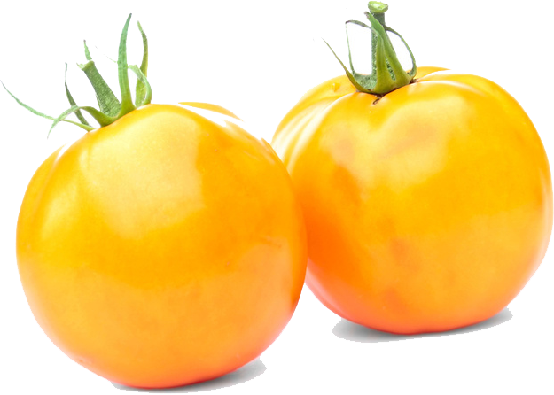
Back to the future
Tomatoes
Originally it is coming from the
generations of pea.
1. What does a monogenic inheritance mean?
2. What are recessive-dominant alleles?
3. What does homozygous, heterozygous mean?
Part III / 3 – Probability, experiments, statistic
Gergely Wintsche
Notes:
Classic problem. There are some properties what depends on only a single gene.
If there are allels in a gene and they are different and one is dominant above the other. Esp. The form of the peas were roundish or closer to the cube. There are some genetic based diseases.
A cell is said to be homozygous for a particular gene when identical alleles of the gene are present on both chromosomes.
is heterozygous at a gene locus when its cells contain two different alleles of a gene.

Slide 4
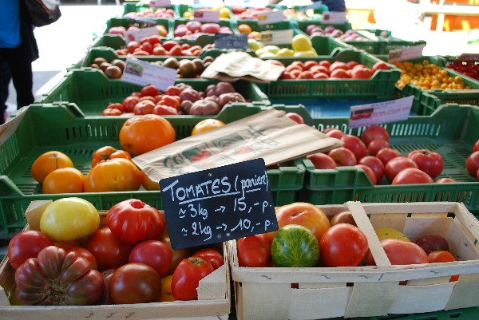
Inheritance
Tomatoes
We had plenty of tomatoes yellow and red ones.
First generation
red × red
red × red
red × yellow
yellow × yellow
red × yellow
Second generation
61 red
47 red, 16 yellow
58 red
64 yellow
33 red, 36 yellow
Whic color was the dominant fenotype?
What are the possible and what are the probable fenotypes in the above cases?
Part III / 4 – Probability, experiments, statistic
Gergely Wintsche
Notes:
Red is dominant and the yellow is recessive.
If both parents are heterozygous then (1/4)^61. (one fourth to the sixty-one) If one of the parents is heterozygous then (1/2)^61. If both barents are homozygous then 1.
Recombination tables. Both of them are heterozygous.
If the red parent is heterozygous than the probability of the event is (1/2)^58, otherwise 1.
1.
The case in the third line the red have to be heterozygous.

Slide 5
Experiments
Die
There are three given experiments. The player must choose one of them and repeat it 20 times. He writes down only the results of the experiment. The others have to find out what was the choice of the player.
A: One throws a die and writes 0 if the result was 1 or 2, writes 1 if the result was 3 or 4 and writes 2 if the result was 5 or 6.
B: One throws a die and writes 0 if the result was 1, 2 or 3, writes 1 if the result was 4 or 5 and writes 2 if the result was 6.
C: One throws a die and writes 0 if the result was 1, writes 1 if the result was 2, 3, 4 or 5 and writes 2 if the result was 6.
Part III / 5 – Probability, experiments, statistic
Gergely Wintsche
Notes:
Let us change the subject and use some dice.
Uniform distribution.

Slide 6

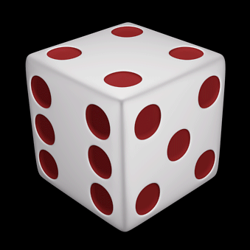
Experiments
Die
After the first experiment we got the series:
2, 2, 1, 1, 0, 0, 0, 1, 0, 1, 1, 1, 1, 2, 2, 1, 1, 2, 0, 0
Try to find out the player’s choice!
How could you make a decision?
Do you make the correct decision after all results?
Part III / 6 – Probability, experiments, statistic
Gergely Wintsche

Slide 7

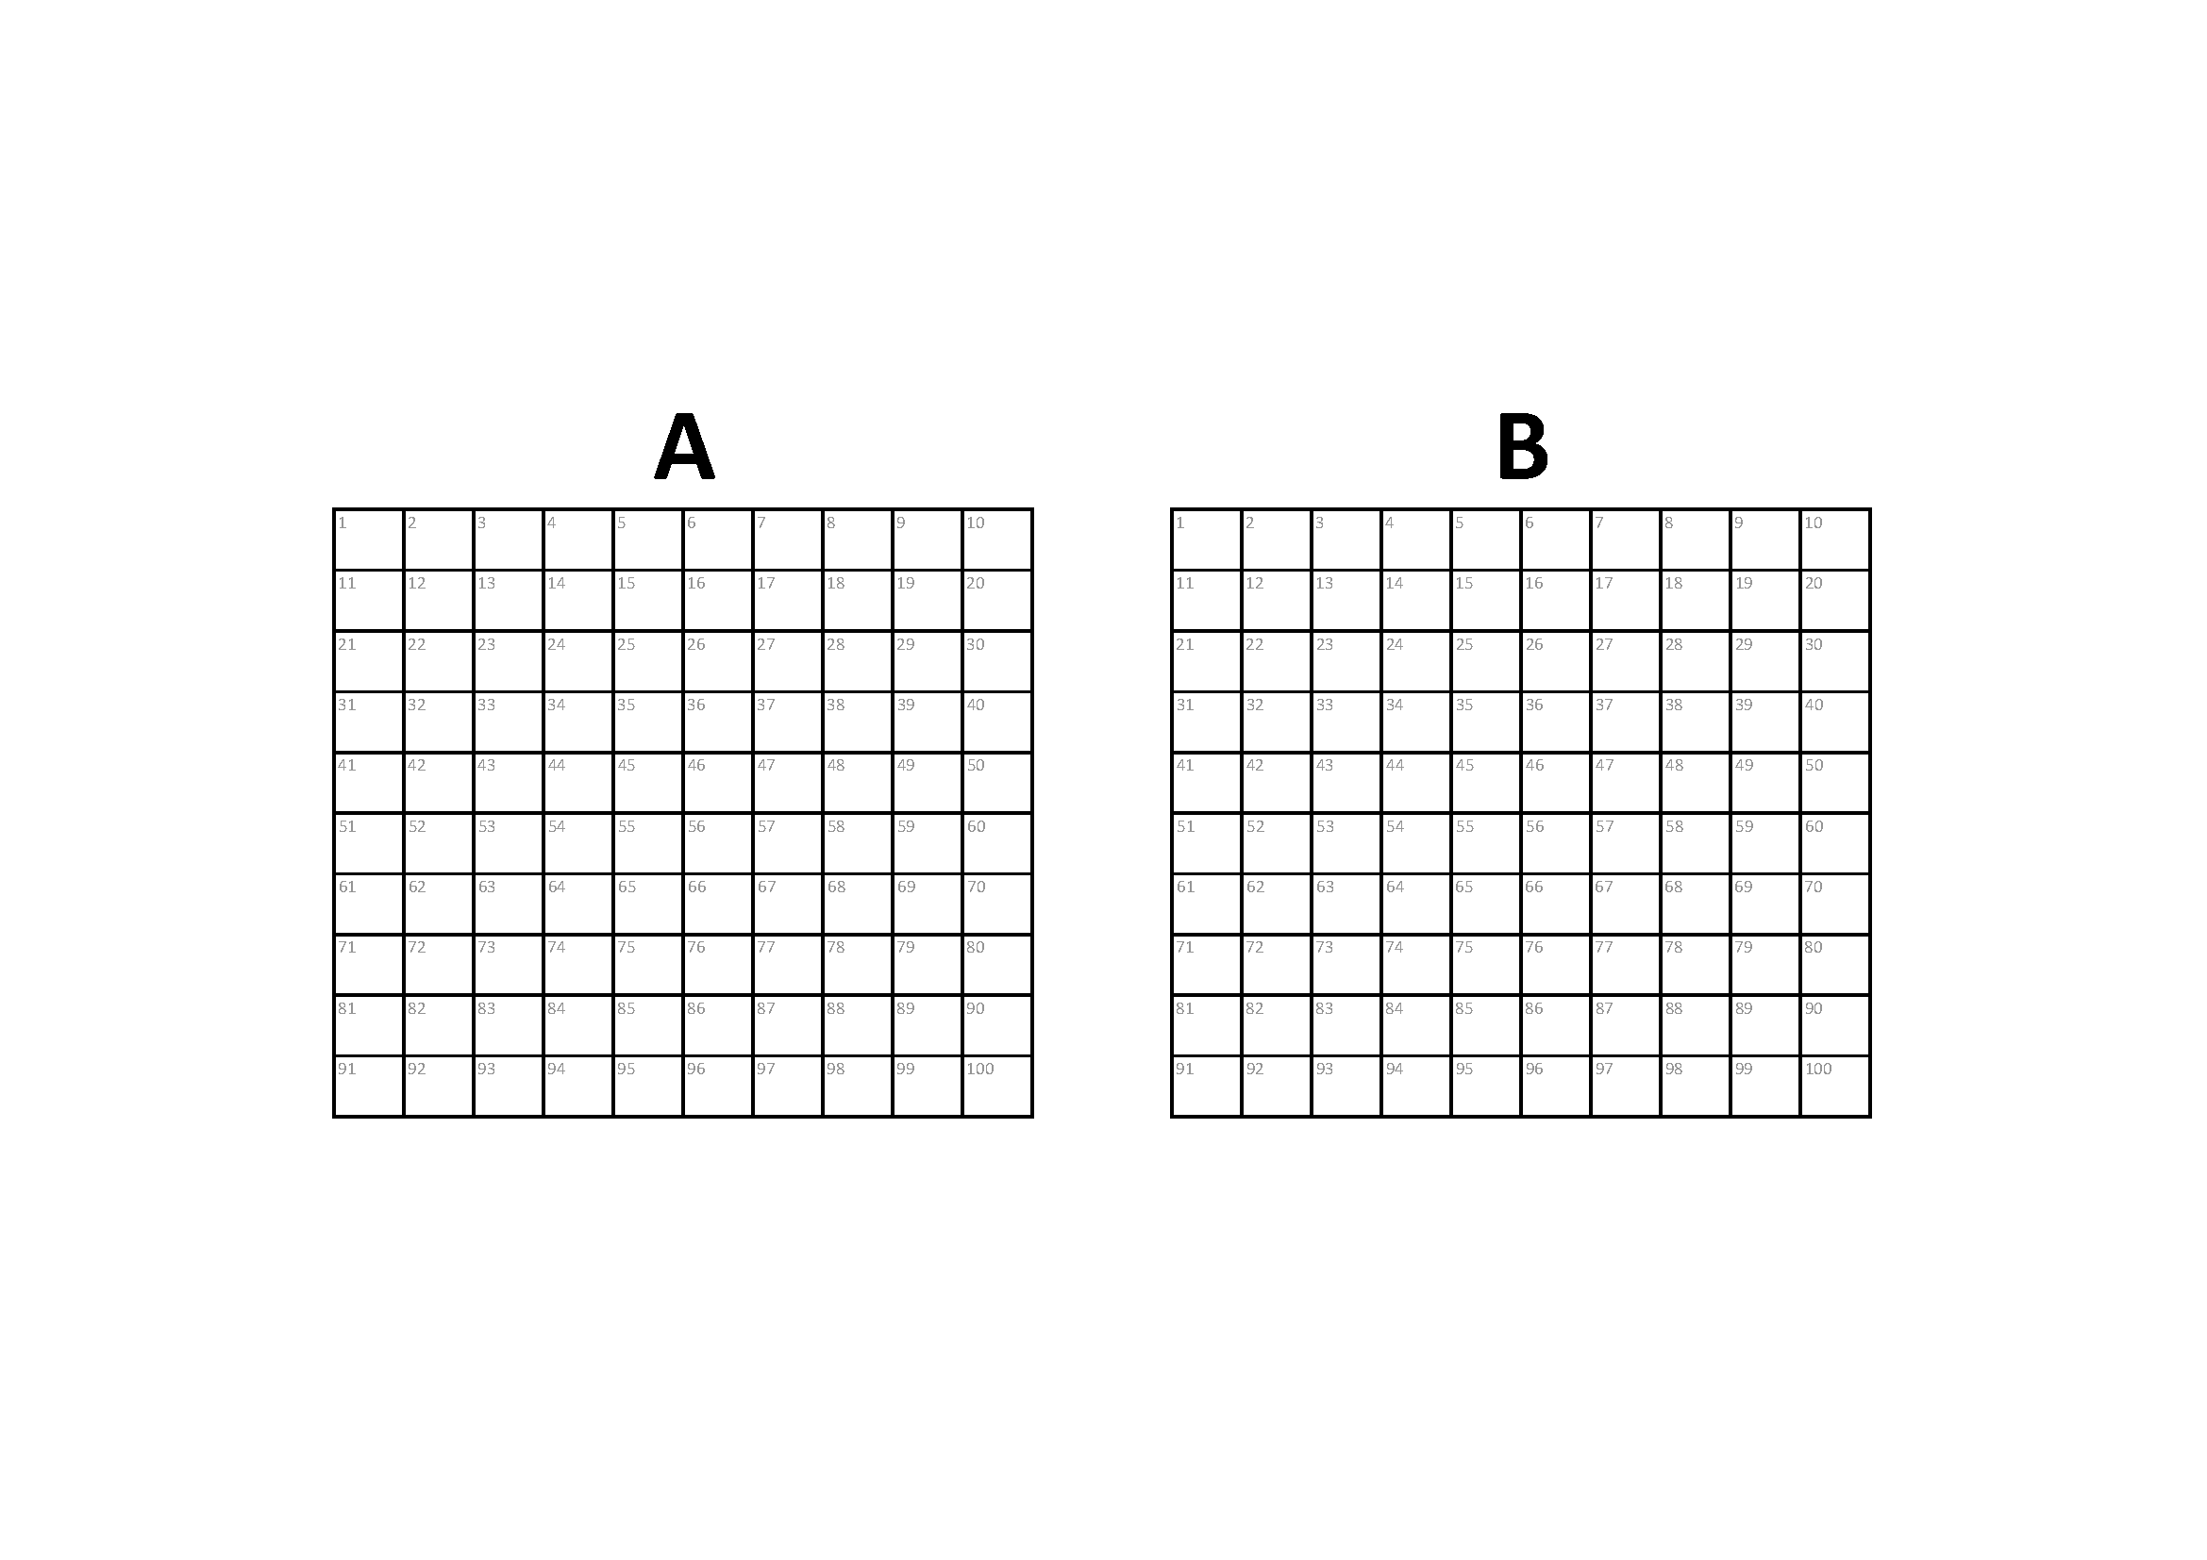
Head runs
Click here to play movie
Head or Tails
You get a paper. There are two empty tables on it
signed with A and B. Both tables have 100 fields.
Choose one of the table and write H or T in the fields as you can imagine a random head or tail series. You do not necessarily have to choose table A. Please read the page full before you start it.
Take a coin run the trial and fill in the other table with the real data series.
Share your tables with me and with your neighbours and try to find out which table was artificially completed and which series originated from the real coin tossing experiment.
Discuss your decision method.
Part III / 7 – Probability, experiments, statistic
Gergely Wintsche
Notes:
The longest head or tail run.

Slide 8
Head runs
Head runs
List all possible sequences in a three long H-T series.
Derive the probability of the longest head run. Let us suppose that the coin is fair, so the probability of head and tail is ½.
Calculate the average length of the longest head run.
 |  | Exactly k long head run
 |  | 0 | 1 | 2 | 3
n long series | 1 | 1 | 1
 | 2 | 1 | 2 | 1
 | 3 | 1 | 4 | 2 | 1
1/8 · 0 + 4/8 · 1 + 2/8 · 2 + 1/8 ·3 = 11/8
Part III / 8 – Probability, experiments, statistic
Gergely Wintsche

Slide 9
Head runs
Head runs
Could you repeat the above calculations for 4, 5, 6, …, n long coin tossing series?
 |  | Exactly k long head run
 |  | 0 | 1 | 2 | 3 | 4 | 5 | 6 | …
n long series | 1 | 1 | 1
 | 2 | 1 | 2 | 1
 | 3 | 1 | 4 | 2 | 1
 | 4 | 1 | 7 | 5 | 2 | 1
 | 5 | 1 | 12 | 11 | 5 | 2 | 1
 | 6 | 1 | 20 | 23 | 12 | 5 | 2 | 1
 | …
Part III / 9 – Probability, experiments, statistic
Gergely Wintsche

Slide 10
Head runs
Head run
I say that it will be easier to deal with the cumulative numbers.
A_{n}(x):= The number of sequences of length n in which the longest run of heads is at most x.
 |  | Exactly k long head run
 |  | 0 | 1 | 2 | 3 | 4 | 5 | 6 | …
n long series | 0 | 1
 | 1 | 1 | 2
 | 2 | 1 | 3 | 4
 | 3 | 1 | 5 | 7 | 8
 | 4 | 1 | 8 | 13 | 15 | 16
 | 5 | 1 | 13 | 24 | 29 | 31 | 32
 | 6 | 1 | 21 | 44 | 56 | 61 | 63 | 64
 | …
Part III / 10 – Probability, experiments, statistic
Gergely Wintsche
Notes:
It is comes from the previous if we sum up the columns.

Slide 11
Head runs
Head runs
Let us see the k = 3 case more accurately.
The trivial question:
If n = 1, 2 or 3 then how many outcomes are favourable?
If n ≤ 3 then A_{n}(3) = 2^{n} clearly (any outcome is OK).
What could be the beginning of a series if n > 3.
If n > 3 then each favorable sequence must begin with
T, HT, HHT or HHHT and it is followed by a subsequence having no more than three conseqcutive heads.
Part III / 11 – Probability, experiments, statistic
Gergely Wintsche

Slide 12
Head runs
Head runs
 |  | Exactly k long head run
 |  | 0 | 1 | 2 | 3 | 4 | 5 | 6 | …
n long series | 0 | 1
 | 1 | 1 | 2
 | 2 | 1 | 3 | 4
 | 3 | 1 | 5 | 7 | 8
 | 4 | 1 | 8 | 13 | 15 | 16
 | 5 | 1 | 13 | 24 | 29 | 31 | 32
 | 6 | 1 | 21 | 44 | 56 | 61 | 63 | 64
 | …
Part III / 12 – Probability, experiments, statistic
Gergely Wintsche

Slide 13
Head runs
Head runs
Could you write a recursion formula for A_{n}(3)?
The proper recursion is
A_{n}(3) = A_{n -1}(3) + A_{n -2}(3) + A_{n -3}(3) + A_{n -4}(3) for n > 3
The values of A_{n}(3) are
n | 0 | 1 | 2 | 3 | 4 | 5 | 6 | 7 | 8 | …
A_{n}(3) | 1 | 2 | 4 | 8 | 15 | 29 | 56 | 108 | 208
Part III / 13 – Probability, experiments, statistic
Gergely Wintsche

Slide 14
Head runs
Heads or tails
T |  | H |  | T |  | T |  | T |  | H |  | T |  | T |  | H |  | H
 | D |  | D |  | S |  | S |  | D |  | D |  | S |  | D |  | S
We can code a TH sequence into a one sign shorter DS sequence.
If we denote B_{n}(x) the number of sequences when the longest H or T run is at most x, then
B_{n}(x) = 2A_{n – 1}(x – 1) for x ≥ 1
Part III / 14 – Probability, experiments, statistic
Gergely Wintsche

Slide 15
Head runs
Head or tails / average
Let P(head) = p and P(tail) = q. (p + q = 1) If it is a fair
coin then p = q = ½.
Every head run starts at the beginning or after a tail. (We will allow 0 long head runs.)
There will be ≈nq head runs.
There will be ≈nqp head runs contains at least one head.
There will be ≈nqp² head runs contains at least two heads.
There will be ≈nqp^{x} head runs contains at least x heads.
If p = ½ then
If
Part III / 15 – Probability, experiments, statistic
Gergely Wintsche

