Slide 1
Generalization
through problem solving
Part II.
The Wallace-Bolyai-Gerwien theorem
Cut a quadrilateral into 2 halves
Gergely Wintsche
Mathematics Teaching and Didactic Center
Faculty of Science
Eötvös Loránd University, Budapest
CME12, 2012.07.02. – Rzeszów, Poland Gergely Wintsche

Slide 2
Outline
1. Dissections, examples
2. The Wallace-Bolyai-Gerwein theorem
3. Cutting a quadrilateral
The basic lemma
Triangle
Trapezoid
Quadrilateral
Part II / 2 – Cut a quadrilateral into 2 halves
Gergely Wintsche

Slide 3
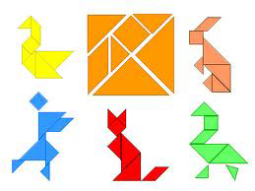
The tangram
Part II / 3 – Cut a quadrilateral into 2 halves
Gergely Wintsche

Slide 4
The pentominos
Part II / 4 – Cut a quadrilateral into 2 halves
Gergely Wintsche

Slide 5
Introduction
The Wallace-Bolyai-Gerwien theorem
„Two figures are congruent by dissection when either can be divided into parts which are respectively congruent with the corresponding parts the other.” (Wallace)
Any two simple polygons of equal area can be dissected into a finite number of congruent polygonal pieces.
Part II / 5 – Cut a quadrilateral into 2 halves
Gergely Wintsche

Slide 6
Introduction
The Wallace-Bolyai-Gerwien theorem
Let us do it by steps:
Proove that any triangle is dissected into a parallelogramma.
Any parallelogramma is dissected into a rectangle.
Part II / 6 – Cut a quadrilateral into 2 halves
Gergely Wintsche

Slide 7
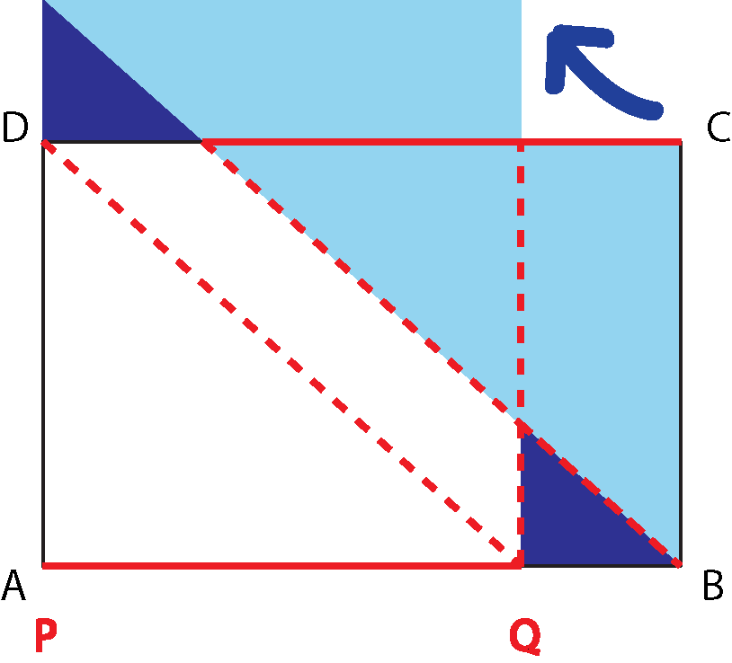
Introduction
The Wallace-Bolyai-Gerwien theorem
3. Any rectangle is dissected into a rectangle with a given side.
Part II / 7 – Cut a quadrilateral into 2 halves
Gergely Wintsche

Slide 8
Introduction
The Wallace-Bolyai-Gerwien theorem
We are ready!
Let us triangulate the simple polygon.
Every triangle is dissected into a rectangle.
Every rectangle is dissected into rectangles with a same side and all of them forms a big rectangle.
We can do the same with the other polygon and we can tailor the two rectangles into each other.
Part II / 8 – Cut a quadrilateral into 2 halves
Gergely Wintsche

Slide 9
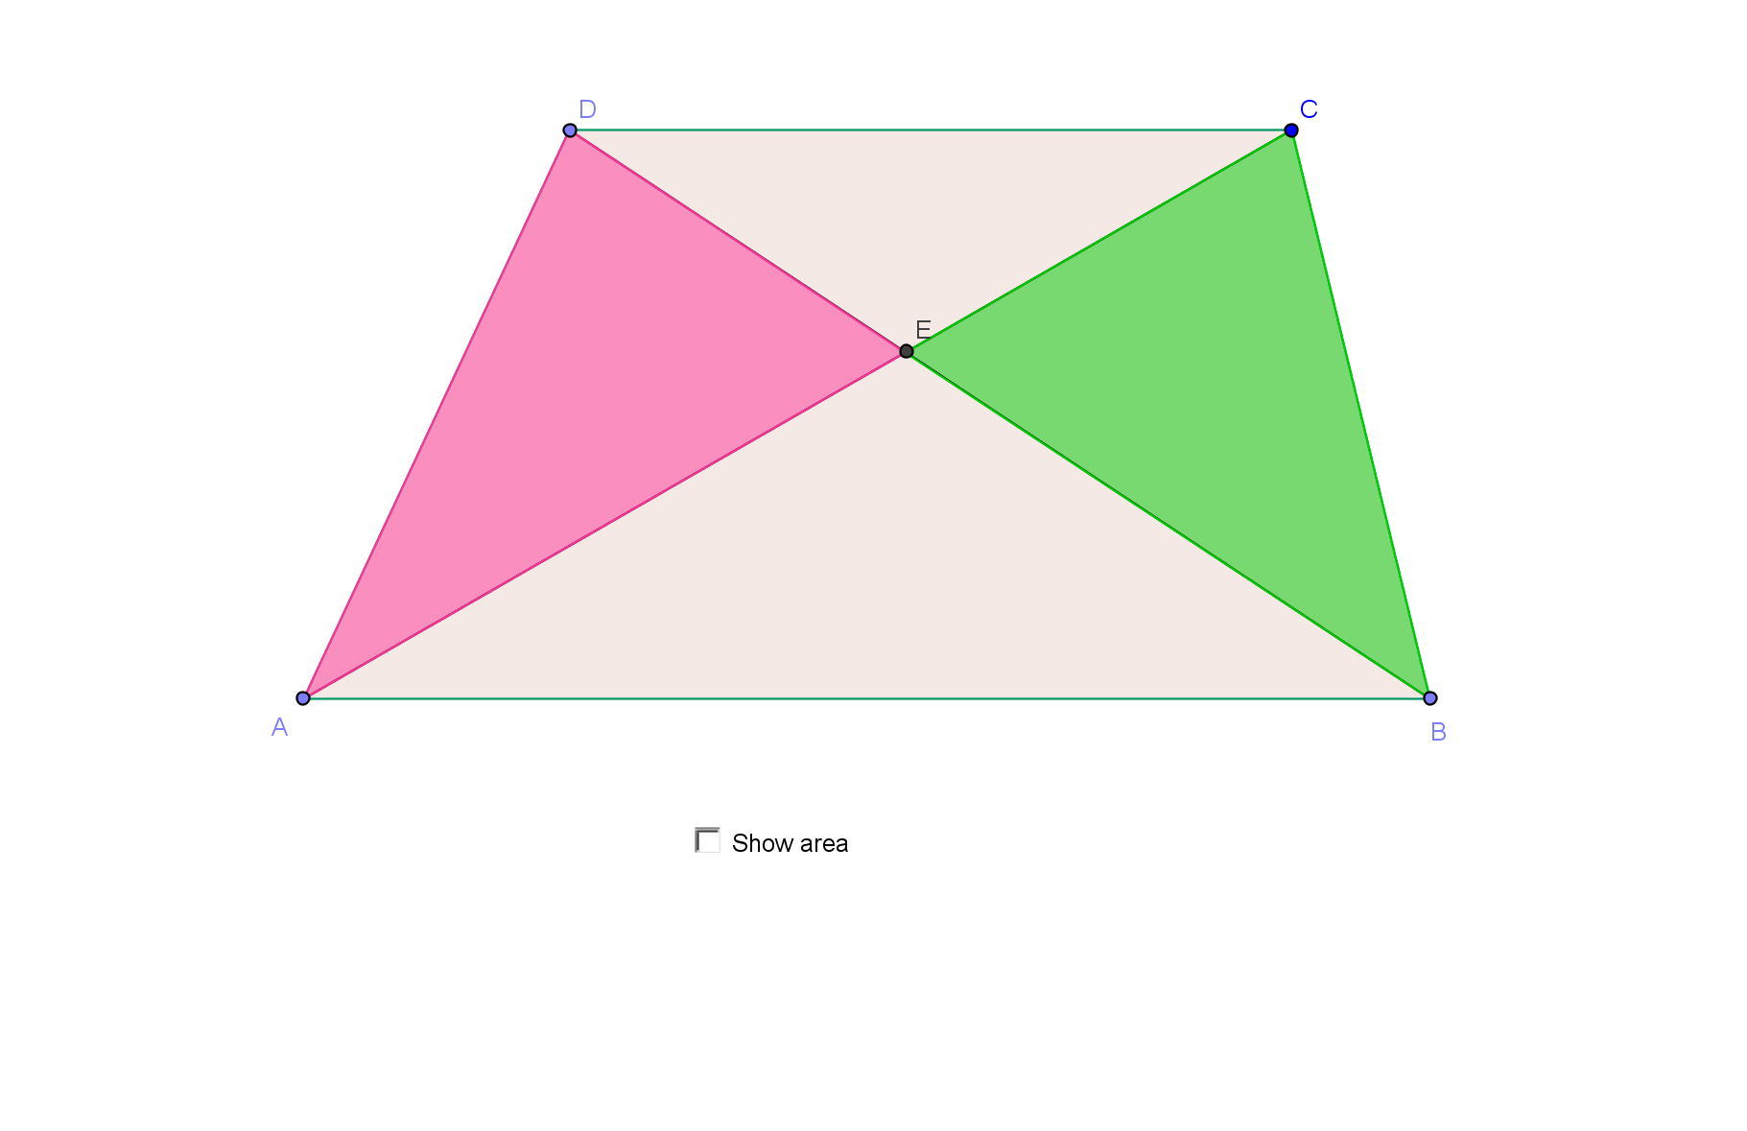
Introduction
The basic problem
Let us prove that the t_{AED} (red) and the t_{BCE} (green ) areas are equal.
Part II / 9 – Cut a quadrilateral into 2 halves
Gergely Wintsche

Slide 10
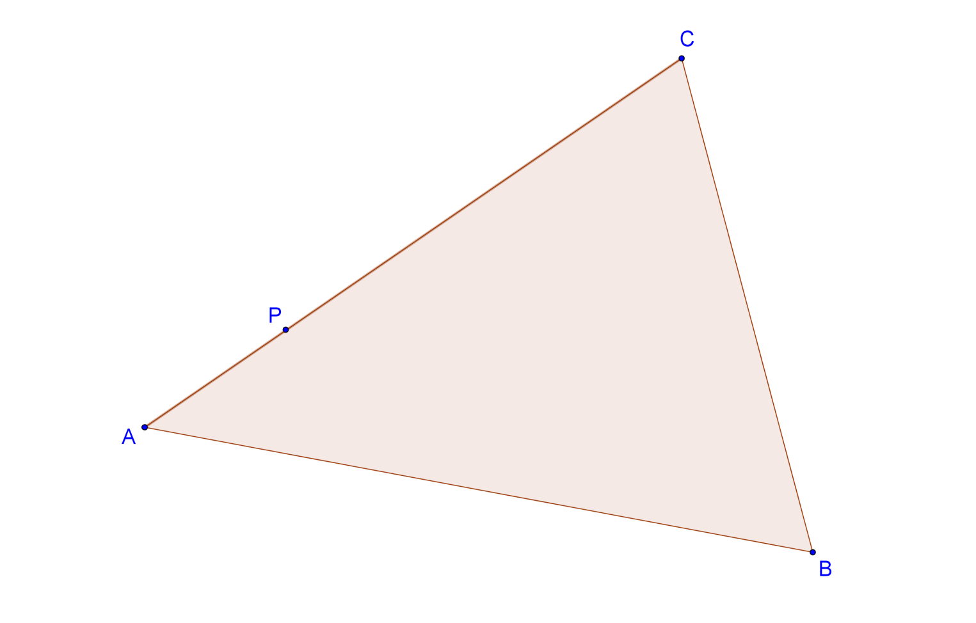
Introduction
The triangle
There is a given P point on the AC side of an ABC triangle. Constract a line through P which halves the area of the triangle.
Part II / 10 – Cut a quadrilateral into 2 halves
Gergely Wintsche

Slide 11
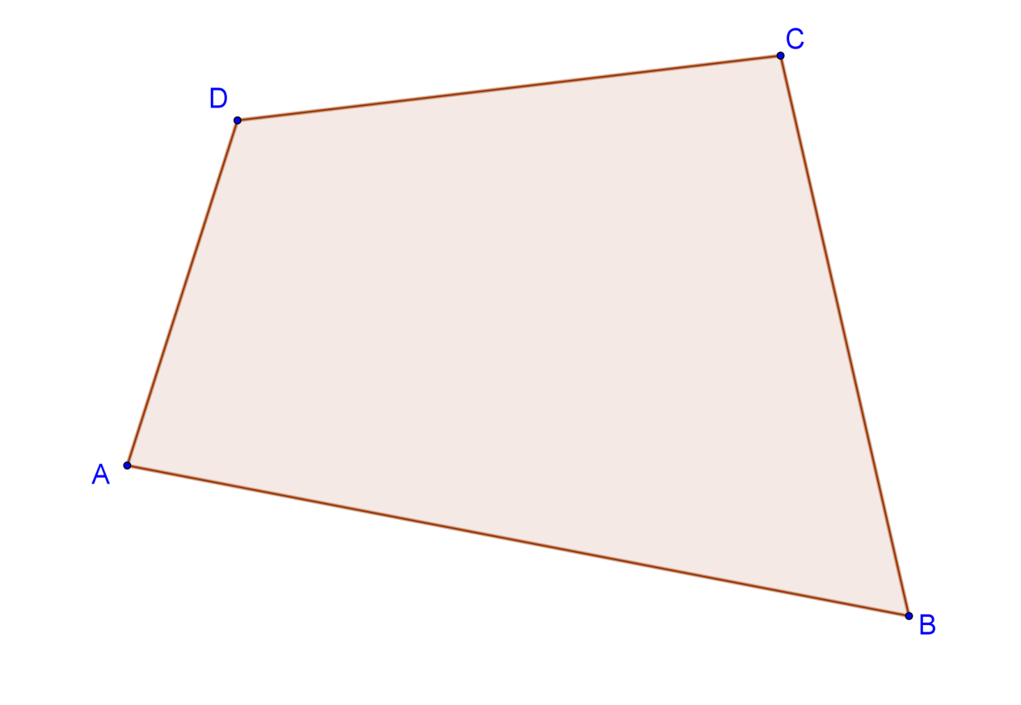
Introduction
The quadrilateral
Construct a line through the vertex A of the ABCD quadrilateral which cuts the area of it into two halves.
(Varga Tamás Competition 89-90, grade 8.)
Part II / 11 – Cut a quadrilateral into 2 halves
Gergely Wintsche

Slide 12
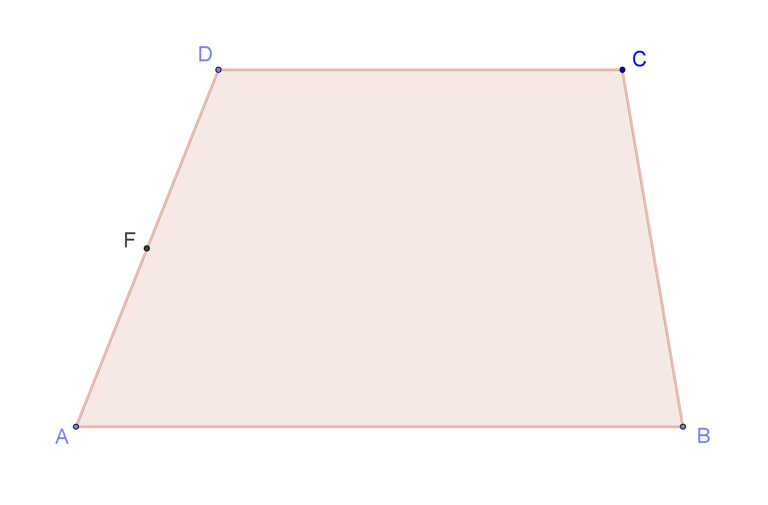
Introduction
The trapezoid
Construct a line through the midpoint of the AD, which halves the area of the ABCD trapezoid.
(Kalmár László Competition 93, grade 8.)
Part II / 12 – Cut a quadrilateral into 2 halves
Gergely Wintsche

Slide 13
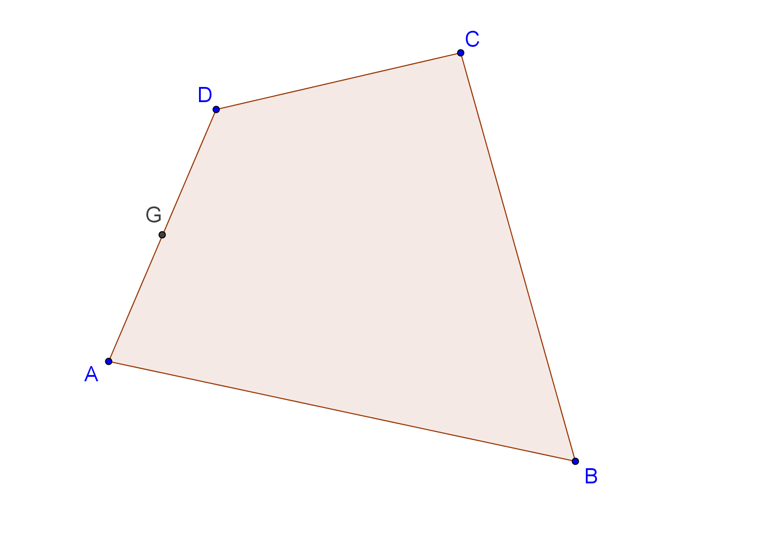
Introduction
Quadrilateral
Cut the ABCD quadrilateral into two halves with a line that goes through the midpoint of the AD edge.
Part II / 13 – Cut a quadrilateral into 2 halves
Gergely Wintsche

Slide 14
Introduction
Solution (1)
Cut the ABCD quadrilateral into two halves with a line that goes through the midpoint of the AD edge.
Part II/ 14 – Cut a quadrilateral into 2 halves
Gergely Wintsche

Slide 15
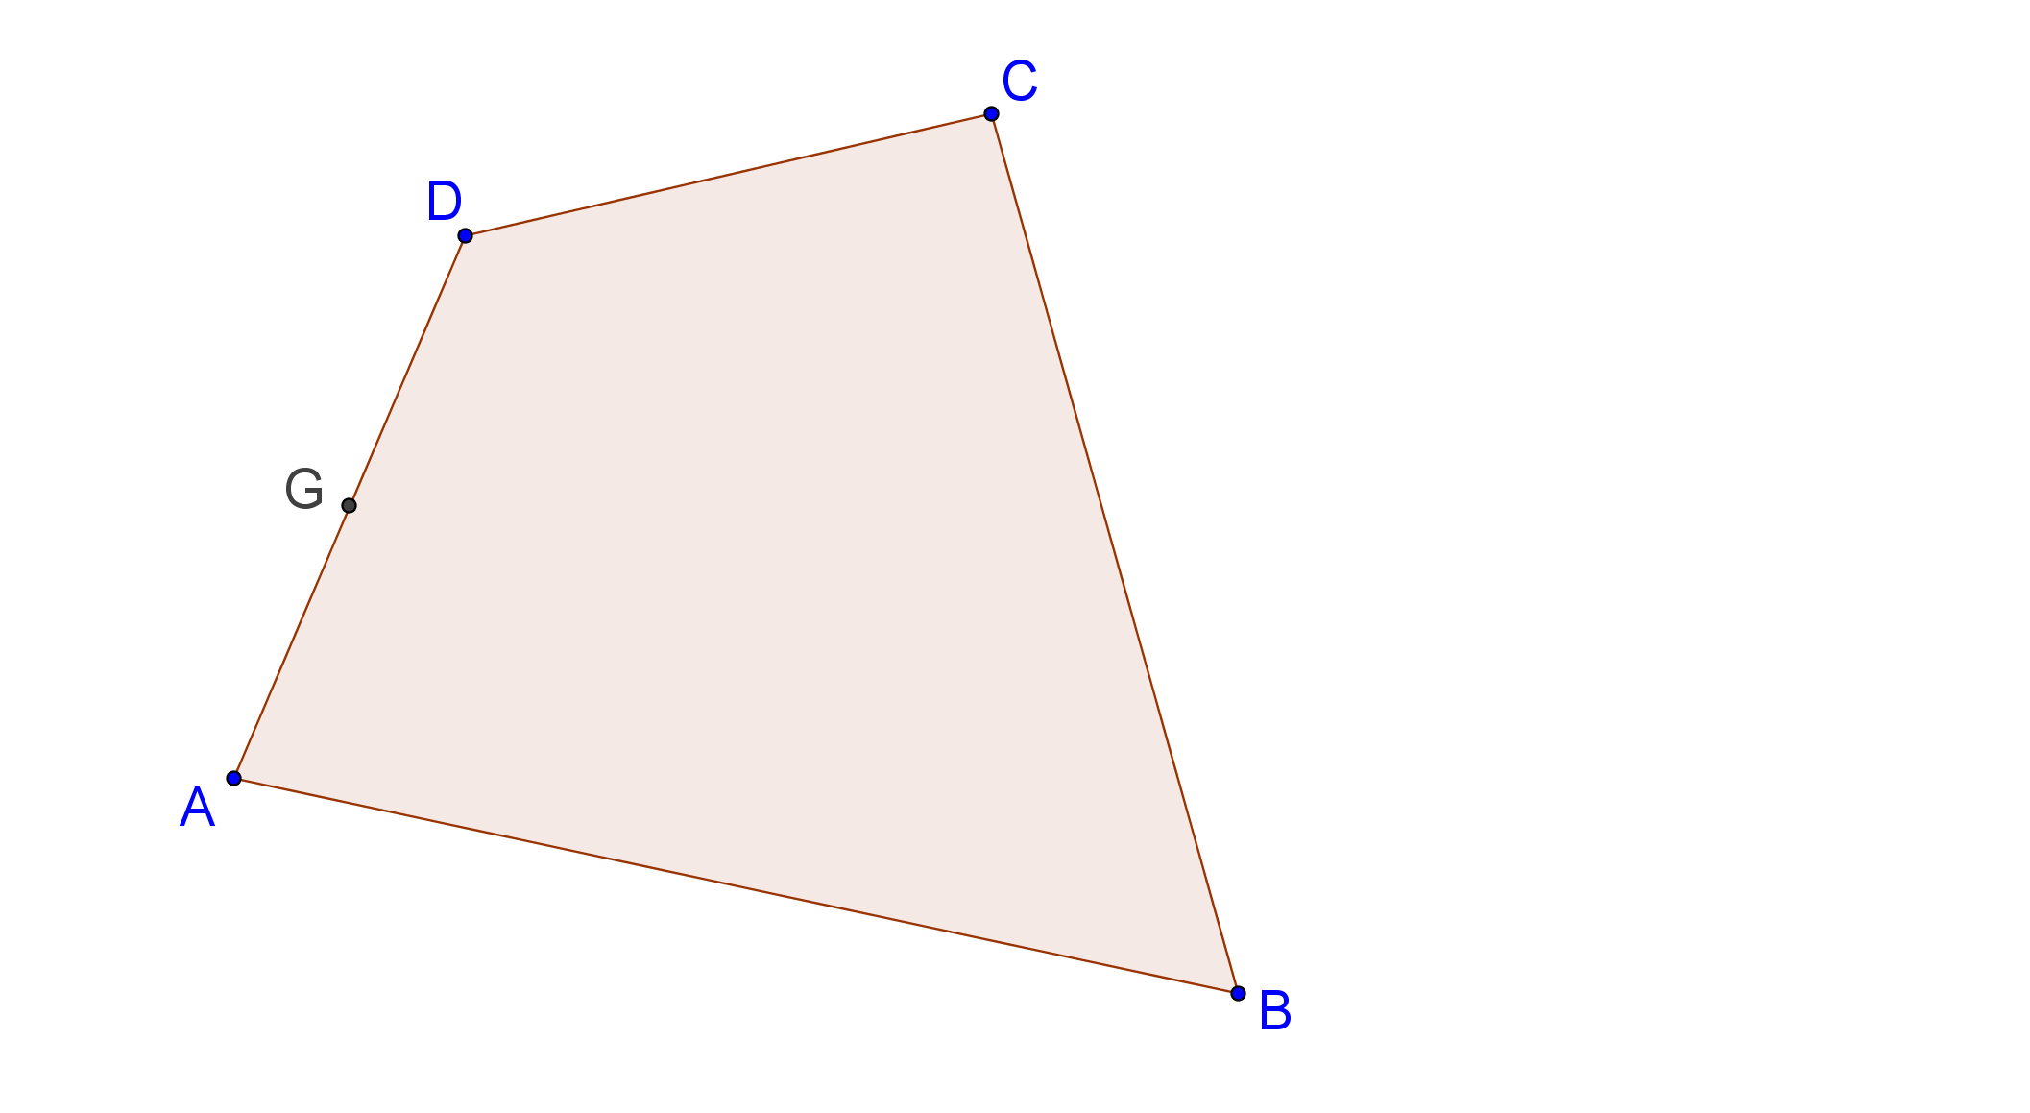
Introduction
Solution (2)
Cut the ABCD quadrilateral into two halves with a line that goes through the midpoint of the AD edge.
Part I / 15 – Cut a quadrilateral into 2 halves
Gergely Wintsche

Slide 16
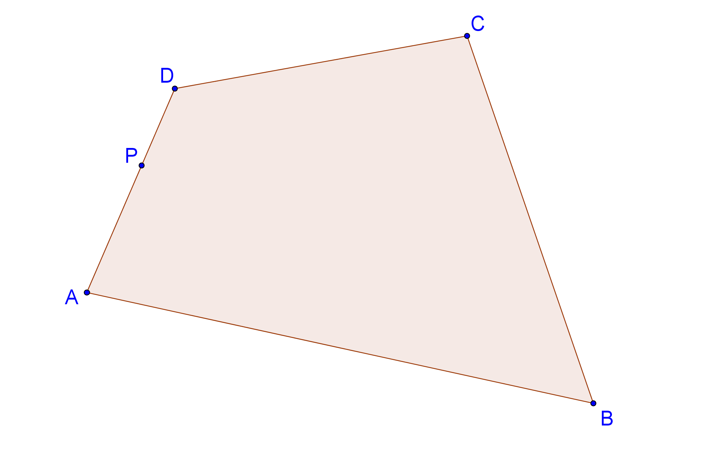
Introduction
The quadrilateral
Cut the ABCD quadrilateral into two halves with a line that goes through the P point on the edges.
Part II / 16 – Cut a quadrilateral into 2 halves
Gergely Wintsche

