Slide 1



Generalization
through problem solving
Part I.
Coloring and folding regular solids
Gergely Wintsche
Mathematics Teaching and Didactic Center
Faculty of Science
Eötvös Loránd University, Budapest
CME12, 2012.07.02. – Rzeszów, Poland Gergely Wintsche

Slide 2

Outline
1. Introduction – around the word
2. Coloring the cube
The frames of the cube
The case of two colors
The case of six colors
The case of the rest
3. Coloring the tetrahedron
4. Coloring the octahedron
5. The common points
6. The football
Part I / 2 – Coloring and folding regular solids
Gergely Wintsche

Slide 3
Introduction – Around the word
The question
Please write down in a few words what do you think if you hear generalization. What is your first impression? How frequent was this phrase used in the school? (I am satisfied with Hungarian but I appreciate if you write it in English.)
Part I / 3 – Coloring and folding regular solids,
Gergely Wintsche

Slide 4
Introduction – Around the word
The answers –first student
”Generalization is when we have facts about something, which is true and we make assumptions about other things with the same
properties. Like 4 and 6 is divisible by 2 we can generalize this information to even number divisibility. In school we didn’t use this phrase very much because everybody else just wanted to survive math class so we didn’t get into things like this.”
Part I / 4 – Coloring and folding regular solids,
Gergely Wintsche

Slide 5
Introduction – Around the word
The answers –second student
”To catch the meaning of the problem. Undress every useless information, what has no effect on the solution of the problem. Generally hard task, but interesting, we have to understand the problem completely, not enough to see the next step but all of them.
Not generally used in schools.”
Part I / 5 – Coloring and folding regular solids,
Gergely Wintsche

Slide 6
Introduction – Around the word
The answers –third student
”To prove something for n instead of specific number. I have made up my mind about some mathematical meaning first but after it about other average things as well. In this meaning we use it in schools very frequently at least weekly.”
Part I / 6 – Coloring and folding regular solids,
Gergely Wintsche

Slide 7
Introduction – Around the word
The answers –wiki
http://en.wikipedia.org/wiki/Generalization
”... A generalization (or generalisation) of a concept is an extension of the concept to less-specific criteria. It is a foundational element of logic and human reasoning. [citation needed] Generalizations posit the existence of a domain or set of elements, as well as one or more common characteristics shared by those elements. As such, it is the essential basis of all valid deductive inferences. The process of verification is necessary to determine whether a generalization holds true for any given situation...”
Part I / 7 – Coloring and folding regular solids,
Gergely Wintsche

Slide 8
Introduction – Around the word
The answers – wiki
Example:
”... A polygon is a generalization of a
3-sided triangle, a 4-sided quadrilateral, and so on to n sides. A hypercube is a generalization of a 2-dimensional square,
a 3-dimensional cube, and so on to n dimensions...”
Part I / 8 – Coloring and folding regular solids,
Gergely Wintsche

Slide 9
Introduction – Around the word
The answers –
Marriam-Webster dictionary
Definition of GENERALIZATION
the act or process of generalizing
a general statement, law, principle, or proposition
the act or process whereby a learned response is made to a stimulus similar to but not identical with the conditioned stimulus
or some extra words
a statement about a group of people or things that is based on only a few people or things in that group
the act or process of forming opinions that are based on a small amount of information
Part I / 9 – Coloring and folding regular solids,
Gergely Wintsche

Slide 10
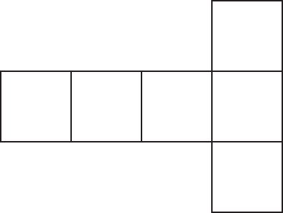
Coloring the cube
The frame of the cube
Before we color anything please draw the
possible frames of a cube.
For example:
Part I / 10 – Coloring and folding regular solids,
Gergely Wintsche

Slide 11
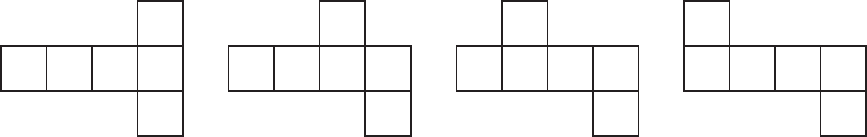
Coloring the cube
The possible frames of the cube
Part I / 11 – Coloring and folding regular solids,
Gergely Wintsche

Slide 12
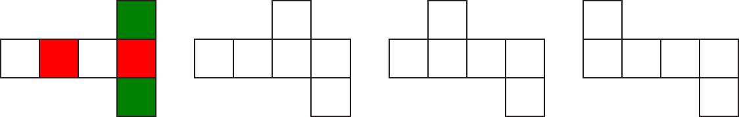
Coloring the cube
Coloring the opposite faces
Please color the opposite faces of a cube with the same color. Let us use the color red, green and white (or anything else).
For example:
Part I / 12 – Coloring and folding regular solids,
Gergely Wintsche

Slide 13
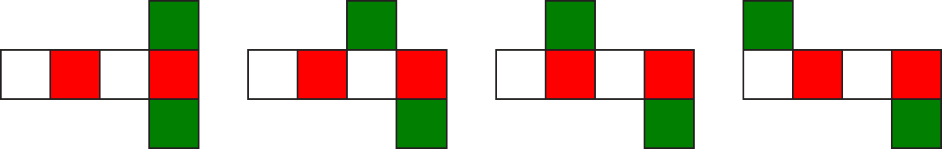
Coloring the cube
Coloring the opposite faces
All frames are colored
Part I / 13 – Coloring and folding regular solids,
Gergely Wintsche

Slide 14
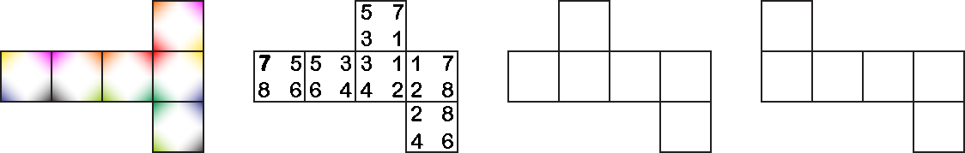
Coloring the cube
Coloring the matching vertices
Please fill the same color of the matching vertices of a cube. (You can use numbers instead of colors if you wish.)
For example:
Part I / 14 – Coloring and folding regular solids,
Gergely Wintsche

Slide 15
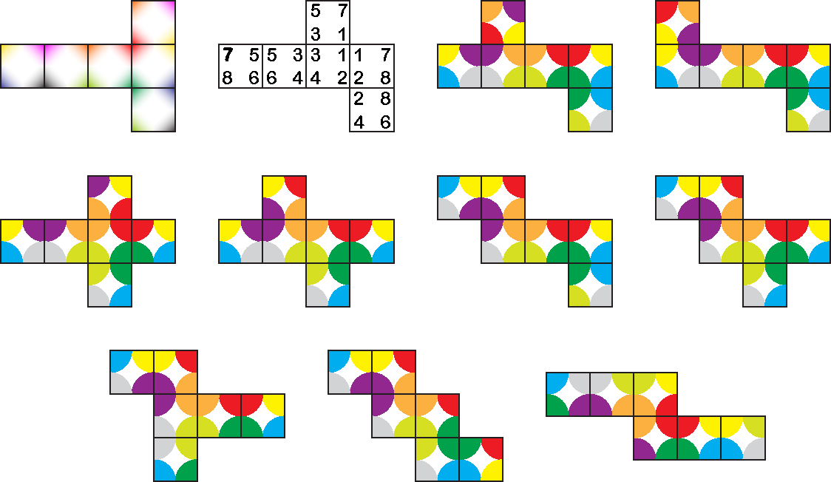
Coloring the cube
Coloring the matching vertices
All vertices are colored.
Part I / 15 – Coloring and folding regular solids,
Gergely Wintsche

Slide 16
Coloring the cube
Coloring the faces of the cube with (exactly) two colors
Calculate the number of different colorings of the cube with two colors. Two colorings are distinct if no rotation transforms one coloring into the other.
Red | Green | # number
1 | 5
2 | 4
3 | 3
4 | 2
5 | 1
Part I / 16 – Coloring and folding regular solids,
Gergely Wintsche

Slide 17
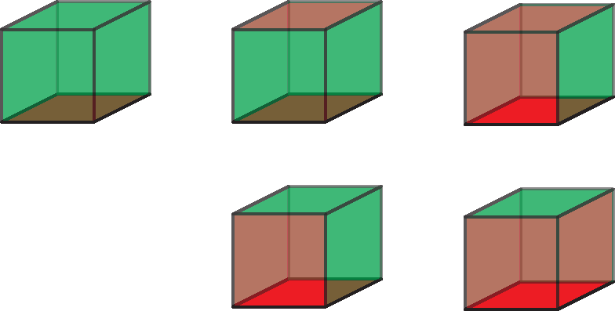
Coloring the cube
Coloring the faces of the cube with (exactly) two colors
Red | Green | # number
1 | 5 | 1
2 | 4 | 2
3 | 3 | 2
4 | 2 | 2
5 | 1 | 1
Part I / 17 – Coloring and folding regular solids,
Gergely Wintsche

Slide 18
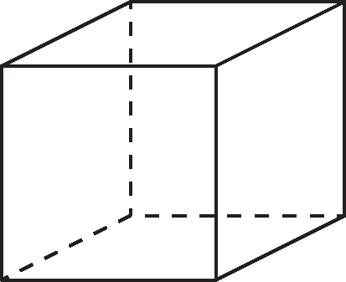
Coloring the cube
Coloring the faces of the cube with (exactly) six colors
We want to color the faces of a cube. How many different color arrangements exist with exactly six colors?
Part I / 18 – Coloring and folding regular solids,
Gergely Wintsche

Slide 19
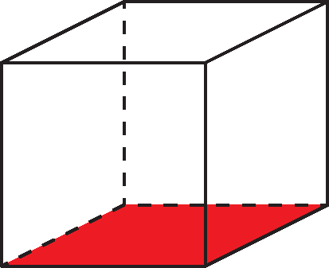
Coloring the cube
Coloring the faces of the cube with (exactly) six colors
Let us color a face of the cube with red and fix it as the base of it.
Part I / 19 – Coloring and folding regular solids,
Gergely Wintsche

Slide 20
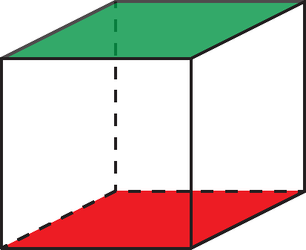
Coloring the cube
Coloring the faces of the cube with (exactly) six colors
There are 5 possibilities for the color of the opposite face.
Let us say it is green.
Part I / 20 – Coloring and folding regular solids,
Gergely Wintsche

Slide 21
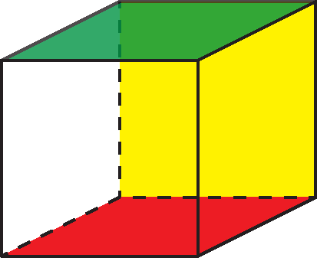
Coloring the cube
Coloring the faces of the cube with (exactly) six colors
The remaining four faces form a belt on the cube. If we color one of the empty faces of this belt with yellow we can rotate the cube to take the yellow face back.
These three faces fix the cube in the space so the remaining three faces are colorable 3·2·1=6 different ways. The total number of different colorings are 5·6=30.
Part I / 21 – Coloring and folding regular solids,
Gergely Wintsche

Slide 22
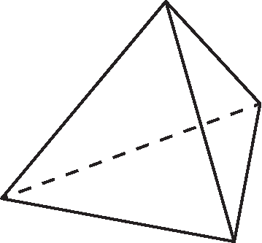
Coloring the tetrahedron
Coloring the faces of the tetrahedron with (exactly) four colors
We want to color the faces of a regular tetrahedron. How many different color arrangements exist with exactly four colors?
Part I / 22 – Coloring and folding regular solids,
Gergely Wintsche

Slide 23
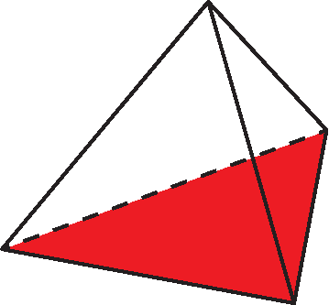
Coloring the tetrahedron
Coloring the faces of the tetrahedron with (exactly) four colors
Let us color a face of the tetrahedron with red and fix it as the base of it.
The other three faces are rotation invariant, so there are only 2 different colorings.
Part I / 23 – Coloring and folding regular solids,
Gergely Wintsche

Slide 24
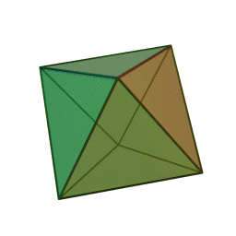

Coloring the octahedron
Coloring the faces of the octahedron (exactly) eight colors
We want to color the faces of a regular octahedron. How many different color arrangements exist with exactly eight colors?
Part I / 24 – Coloring and folding regular solids,
Gergely Wintsche

Slide 25
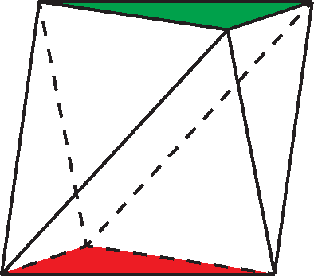
Coloring the octahedron
Coloring the faces of the octahedron with (exactly) four colors
Let us color a face of the octahedron with red and fix it as the base of it. We can color the top of this solid with 7 colors, let us say it is green.
Part I / 25 – Coloring and folding regular solids,
Gergely Wintsche

Slide 26
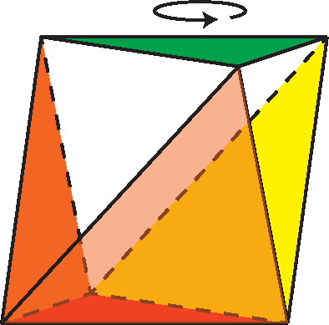
Coloring the octahedron
Coloring the faces of the octahedron with (exactly) four colors
Let us choose the three faces with a common edge of the red face. We have
different possibilities. We had to divide by 3 because if we rotate the octahedron as we indicated it then only the base and the top remains unchanged.
Part I / 26 – Coloring and folding regular solids,
Gergely Wintsche

Slide 27
Coloring the octahedron
Coloring the faces of the octahedron with (exactly) four colors
The remaining three faces can colored by 3·2·1 = 6 different ways, so the total number of colorings is
Part I / 27 – Coloring and folding regular solids,
Gergely Wintsche

Slide 28
Coloring the football
Coloring the faces of the truncated icosahedron
Before we color anything how many and what kind of faces has the truncated icosahedron?
It has 32 faces, 12 pentagons where the icosahedron’s vertices had been originally and 20 hexagons where the icosahedron’s faces had been. The number of different colorings are …
Part I / 28 – Coloring and folding regular solids,
Gergely Wintsche

Slide 29
Symmetry
Symmetry
How many rotation symmetry has the regular tetrahedron?
Part I / 29 – Coloring and folding regular solids,
Gergely Wintsche

Slide 30
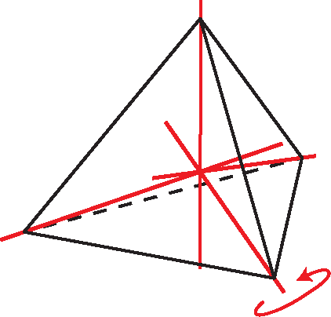
Symmetry
Symmetry
Let us start with the tetrahedron. We can rotate it around 4 axes ±120° alltogether 4·2 = 8 ways + 3 180° rotation arond the axes go through the midpoints of two opposite edge + 1 identity.
If we distinguish all the sides of the tetrahedron then the coloring number is 4! = 24. But we found 12 rotation symmetry, so we get 24 / 12 = 2 different coloring.
Part I / 30 – Coloring and folding regular solids,
Gergely Wintsche

Slide 31
Symmetry
Symmetry
How many rotation symmetry has the cube?
Part I / 31 – Coloring and folding regular solids,
Gergely Wintsche

Slide 32
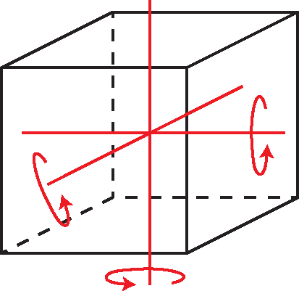
Symmetry
Symmetry
Let us continue with the cube. We can rotate it around 3 axes (they go through the midpoints of the opposite faces 3·3 = 9 different ways + 1 identity = 10.
We can choose the axes go through on the midpoints of the oppsite edges as the case of the tetrahedron. It gives 6 more rotations.
Part I / 32 – Coloring and folding regular solids,
Gergely Wintsche

Slide 33
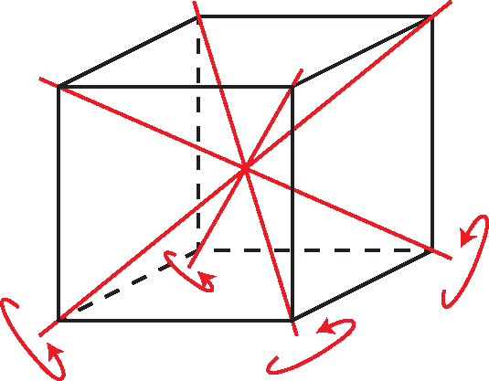
Symmetry
Symmetry
There are 4 more rotation axis: the diagonals. It means 4·2 = 8 more rotatations.
If we sum up then we get the 10+6+8=24 rotation. (We will not prove that these rotations give the whole rotation group but can be checked easily.)
If we distinguish the faces of the cube it is colorable in 6! = 720 different ways.
720 / 24 = 30
Part I / 33 – Coloring and folding regular solids,
Gergely Wintsche

Slide 34
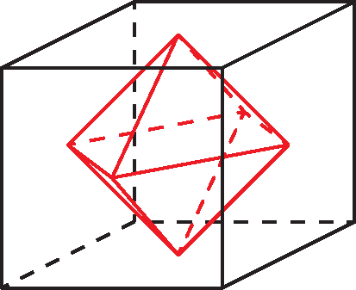
Symmetry
Symmetry
The rotation symmtries of the octahedron are identical with the symmtries of the cube.
But we have 8! = 40320 different ways to color the 8 faces, and
40320 / 24 = 1680
Part I / 34 – Coloring and folding regular solids,
Gergely Wintsche

Slide 35
Symmetry
Symmetry
Let us go back to the truncated icosahedron the well known football.
How many rotation symmetry has this solid?
Part I / 35 – Coloring and folding regular solids,
Gergely Wintsche

Slide 36
Symmetry
Symmetry
We can move a pentagon to any other pentagon (12 rotation) and we can spin a pentagon 5 times around its center. It gives 60 rotations.
On the other hand we can see the hexagons as well. Every hexagon can move to any other (20 rotation) and we can spin a hexagon 6 times around its center. It gives 120 rotations.
Is there a problem somewhere?
Part I / 36 – Coloring and folding regular solids,
Gergely Wintsche

Slide 37

Summa
Summarize
Solid | Faces | #Symmetry | Coloring
tetrahedron | 4 | 12 | 4! / 12 = 2
cube | 6 | 24 | 6! / 24 = 30
octahedron | 8 | 24 | 8! / 24 = 1680
Football (truncated icosahedron ) | 32 | 60 | 32! / 60 ≈ 4,4·10³³
Part I / 37 – Coloring and folding regular solids,
Gergely Wintsche

Slide 38
Outlook
Outlook
The problem becomes really high level if you ask: How many different colorings exist of a cube with maximum 3-4-n colors. The questions are solvable but we would need the intensive usage of group theory (Burnside-lemma and/or Pólya counting).
Part I / 38 – Coloring and folding regular solids,
Gergely Wintsche
Notes:
+1-2 oldal a részletekről!!

Slide 39
Outlook
Outlook
Let G a finite group which operates on the elements of the X set. Let x ∈ X and x^{g} those elements of X where x is fixed by g. The number of orbits denoted by | X / G |.
Part I / 39 – Coloring and folding regular solids,
Gergely Wintsche
Notes:
+1-2 oldal a részletekről!!

Slide 40
Outlook
The case of cube
The rotations order:
1 identity leaves: 3⁶ elements of X
6 pcs. of 90° rotation around an axe through the midpoints of two opposite faces: 3³
3 pcs. of 180° rotation around an axe through the midpoints of two opposite faces: 3⁴
8 pcs. of 120° rotation around an axe through the diagonal of two opposite vertices: 3²
6 pcs. of 180° rotation around an axe through the midpoints of two opposite edges: 3³
Part I / 40 – Coloring and folding regular solids,
Gergely Wintsche
Notes:
+1-2 oldal a részletekről!!

Slide 41
Outlook
The case of cube
In general sense, coloring options with n colors:
n | (exactly) n colors | (at most) n colors
1 | 1 | 1
2 | 8 | 10
3 | 30 | 57
4 | 68 | 240
5 | 75 | 800
6 | 30 | 2226
Coloring the cube with
Part I / 41 – Coloring and folding regular solids,
Gergely Wintsche
Notes:
+1-2 oldal a részletekről!!

